Slide 1
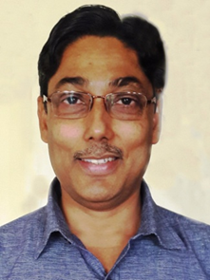
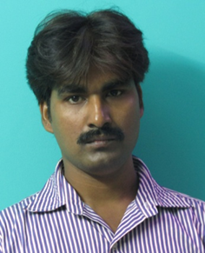
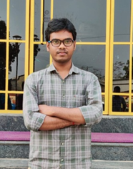
One day International Seminar
on Emerging trends in Science & Technology Organised by Department of Chemistry
Kharagpur College
Kharagpur, Paschim Medinipur, West Bengal, India 721305
Date: 23rd May, 2025: Venue: H. B. Sarkar hall, Kharagpur College
Speakers
Prof (Dr.) Amit Kumar Das
Professor
Bioscience and Biotechnology,
Indian Institute of Technology, Kharagpur
Dr. Subhash Chandra Ghosh
Principal Scientist
Marine Natural Products & Bio Polymer Division
Associate Professor (Ac-SIR-New Delhi)
CSIR- Central Salt & Marine Chemicals Research Institute, Bhavnagar, Gujrat.
Dr. Amaresh Chandra Mishra
Assistant Professor
Department of Natural Sciences, PDPM Indian Institute of Information Technology, Design and Manufacturing, Jabalpur.
Dr. Milan Pramanik
Alumnus. Kharagpur College
Postdoctoral Research Associate
Cardiff University, U.K

Slide 2
Organising Committee
Chairman : Dr. Bidyut Samanta, Principal, Kharagpur College
Organizing Secretary : Smt Kuheli Pramanik, Assistant Professor & Head, Department of Chemistry
Jt. Secretary: Dr. Forid Saikh , Assistant Professor, Department of Chemistry & Sri Sanjoy Kumar Bera, SACT, Department of Chemistry
Jt. Convener:Dr. Subhra Mishra & Dr. Indranil Chakraborty,Associate Professor, Department of Chemistry, Kharagpur College
Advisory committee
Dr. Gagan Chandra Mandal, Associate Professor, Department of Chemistry, Kharagpur College
Sri Prasanna Kumar Duley, Assistant Professor, Department of Chemistry, Kharagpur College
Technical subcommittee
Jt Convener: Dr. Sumit Kumar Ray, Assistant Professor & Sri Kalyan Sur, SACT, Department of Chemistry, Kharagpur College
Reception Subcommittee
Convener: Smt. Laboni Giri, SACT, Department of Chemistry, Kharagpur College

Slide 3
Registration Procedure
Registration fees
For Faculty/Research Scholar : Rs 500/-
For Students : Rs. 200/-
Registration fees can be paid directly to the Department of Chemistry or through UPI to 9733845704
Registration link: https://forms.gle/Dj5kx4Zui4wgQFiz7
Call for presentation
Paper Presentation: Offline and Online mode (Platform: Google Meet, Duration; 08mins)
Poster Dimension: L X W= 100cm X 70 cm
Important Dates
Last date of registration- 21.05.2025
Last date of abstract submission- 20.05.2025
For further query please contact with: 9474620643/ 9474751733/9733845704 or chemistry@kharagpurcollege.ac.in
Link of Google Meet will be shared afterwards.

